Slide 1
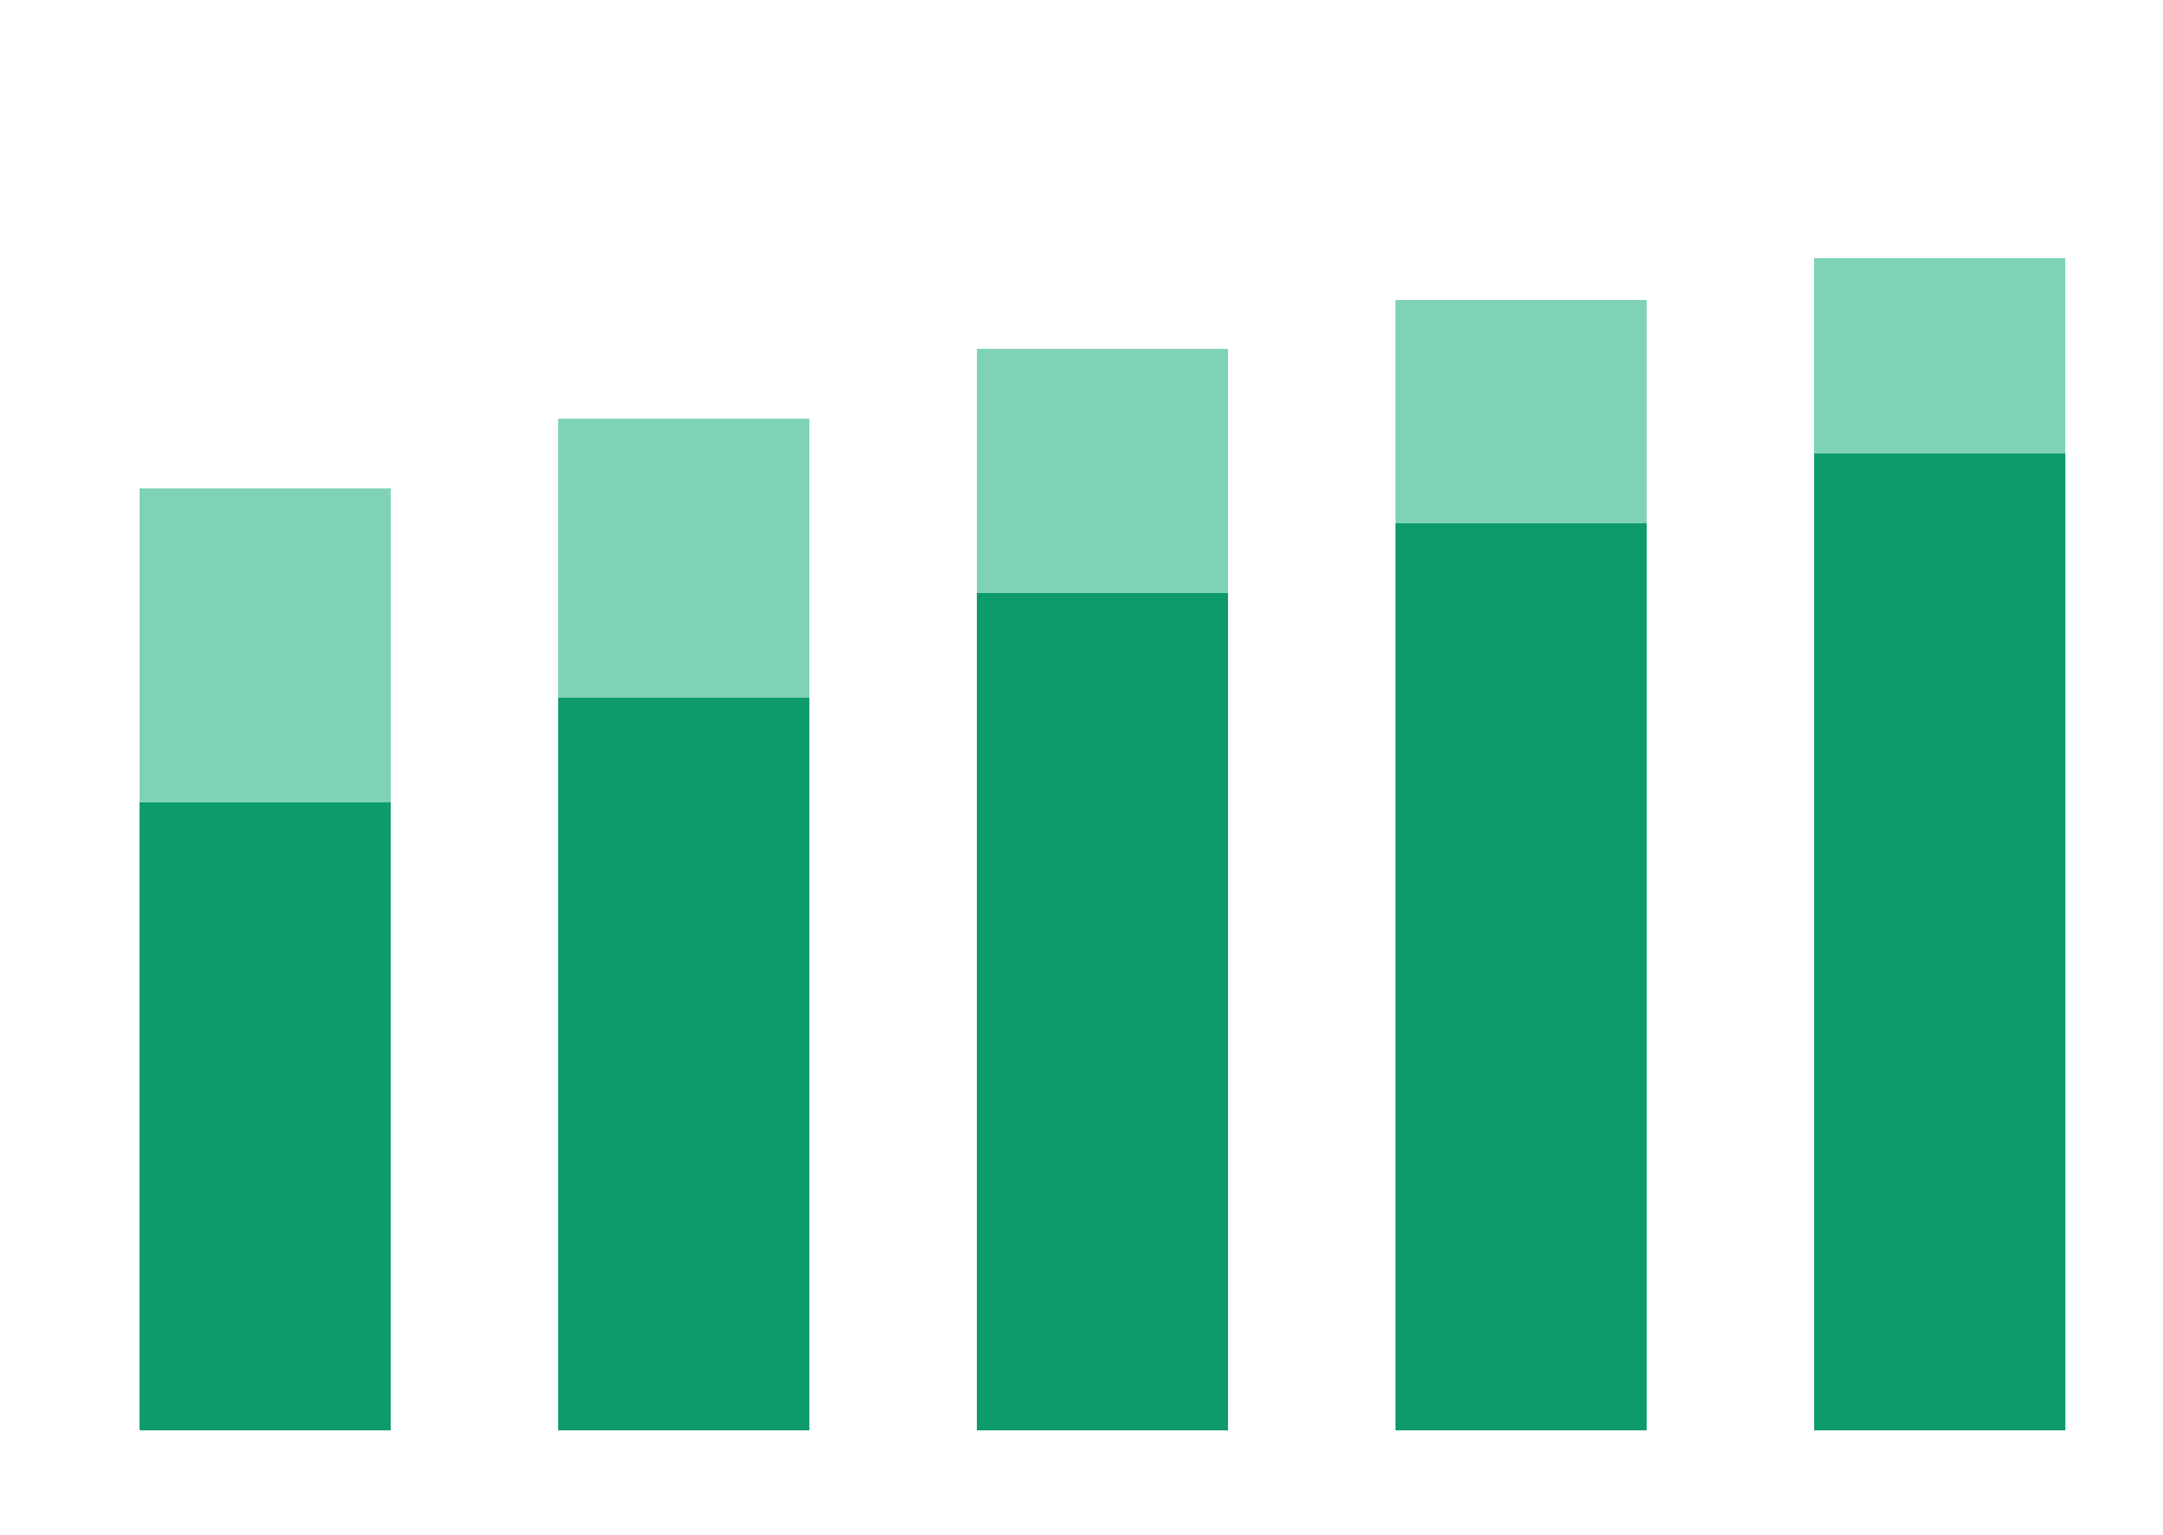
PUBLIC HEALTH RESEARCH
NDHS 2018
Maternal Education, Household Wealth & Childhood Anemia in Nigeria
An analysis using the 2018 Nigeria Demographic and Health Survey
PRESENTER
COURSE
Ejeh Ehi Oluwa-Tosin
Data Analytics & AI
Data Analytics & AI Student
Notes:
Introduce the study: the relationship between maternal education, household wealth, and childhood anemia in Nigeria, using NDHS 2018.

Slide 2



02
BACKGROUND
Childhood anemia in context
A major public health challenge that impairs a child's growth, cognitive development, immunity, and survival — and one that may be shaped by a family's social and economic conditions.
The condition
Maternal education
Household wealth
Anemia weakens immunity and slows early childhood development.
A mother's schooling can shape a child's nutrition and care.
Economic status affects access to food, care, and clean living.
Notes:
Set the stage: anemia is a major child health burden, it impairs development, and socioeconomic factors like maternal education and wealth plausibly shape it.

Slide 3



03
RESEARCH QUESTIONS
What this study asks
RQ1
RQ2
How does a mother's educational level relate to child anemia?
How does the household wealth index relate to child anemia?
Why it matters: answers guide policymakers and health NGOs on where to target education, nutrition, and poverty-reduction programs for the greatest impact on child health.
Notes:
Two questions drive the study. Emphasise why this matters: it directs where policymakers and NGOs should focus limited resources.

Slide 4



04
DATA SOURCE
About the dataset
SOURCE
POPULATION
VARIABLES
Nigeria Demographic & Health Survey (NDHS 2018)
Children aged 0–59 months; mothers aged 15–49 years
Independent: education, wealth · Dependent: anemia status
33,924
4
5
Total records
Education categories
Wealth categories
Notes:
Describe the data source, the population, the variables used, and the overall size of the dataset.

Slide 5






05
METHODOLOGY
From raw data to insight
NDHS dataset
Data cleaning
Data analysis
Visualization
Interpretation
Raw survey data
MySQL
SQL
Power BI
Insights
DATA CLEANING
TOOLS
TECHNIQUES
Checked missing values
Converted blank anemia values to SQL NULL
Excluded missing anemia observations
Excel
MySQL
Power BI
Frequency distribution
Cross-tabulation
Percentage analysis
Notes:
Walk through the pipeline from raw NDHS data to interpretation. Note the cleaning steps and the analytical techniques used.

Slide 6
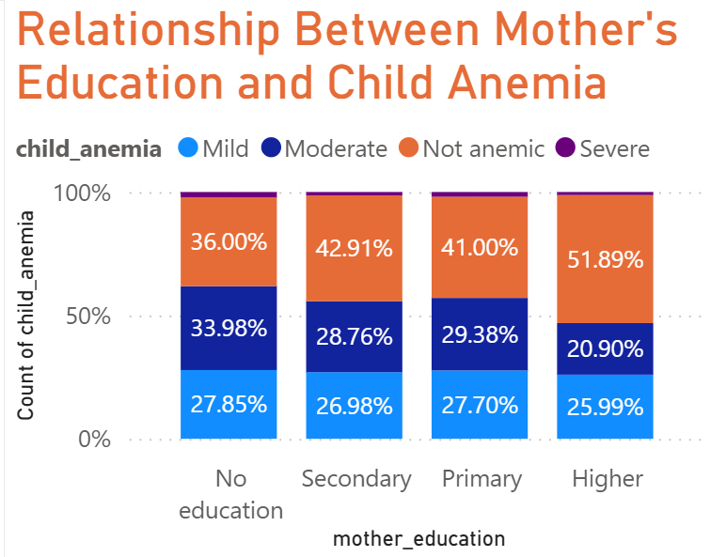


06
FINDINGS · RQ1
Maternal education & child anemia
51.89%
Higher education — highest non-anemic share
36.00%
No formal education — lowest non-anemic share
The non-anemic proportion rises steadily with each level of maternal education.
Maternal education appears positively associated with better child health outcomes.
Notes:
Present the first finding: non-anemic share rises with maternal education, from 12.18% (no education) to 22.42% (higher education). Drop your Power BI stacked column chart into the placeholder.

Slide 7
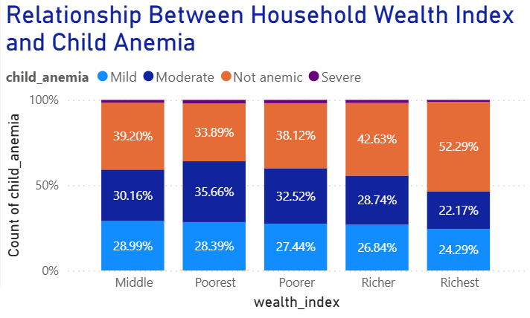
07
FINDINGS · RQ2
Household wealth & child anemia
52.29%
Richest households — highest non-anemic share
39.20%
Poorest households — lowest non-anemic share
The non-anemic proportion increases across each step of the wealth index.
Household wealth appears positively associated with better child health.
Notes:
Present the second finding: non-anemic share rises with household wealth, from 11.60% (poorest) to 22.71% (richest). Drop your Power BI stacked column chart into the placeholder.

Slide 8

08
SUMMARY
Key findings
Higher maternal education is associated with a higher proportion of non-anemic children.
Wealthier households recorded consistently better child anemia outcomes.
Moderate anemia remains common across all socioeconomic groups.
Socioeconomic inequalities may contribute to differences in child health.
Notes:
Summarise the four headline insights before moving to recommendations.

Slide 9


09
RECOMMENDATIONS
Where to act
Government
Health NGOs
Promote female education
Improve maternal healthcare
Expand nutrition programs
Strengthen poverty-reduction initiatives
Target nutrition education toward low-income households
Increase anemia screening
Expand iron supplementation programs
Notes:
Translate findings into action for two audiences: government and health NGOs.

Slide 10
10
CONCLUSION
Maternal education and household wealth are both associated with childhood anemia — children of wealthier households and better-educated mothers showed higher non-anemic proportions.
Education ↑
Wealth ↑
Anemia ↓
Higher maternal schooling, healthier children
Better economic status, better outcomes
A target for education and poverty policy
Notes:
Close the argument: education and socioeconomic improvement are levers for reducing childhood anemia in Nigeria.

Slide 11
Thank you
Questions?
Ejeh Ehi Oluwa-Tosin
Notes:
Thank the audience and open the floor for questions.

